Slide 1
Wireless Personal Area Network (WPAN)
Course Title: Wireless and Mobile Communication Course Code: ICT-4201
Submitted By: Submitted To:
Shajib Mohammad Saifullah Dr. Md. Nazrul Islam ID: IT-21042 Associate Professor 4th year 2nd Semester Dept. of ICT, MBSTU
ICT, MBSTU

Slide 2
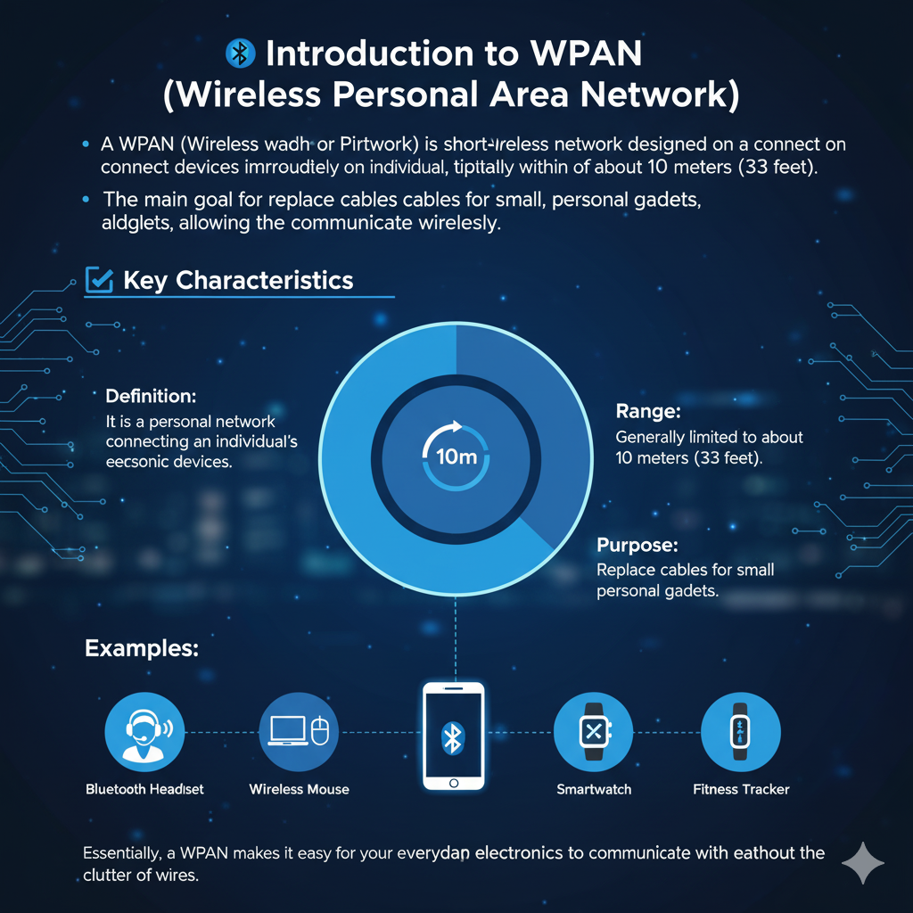

Slide 3
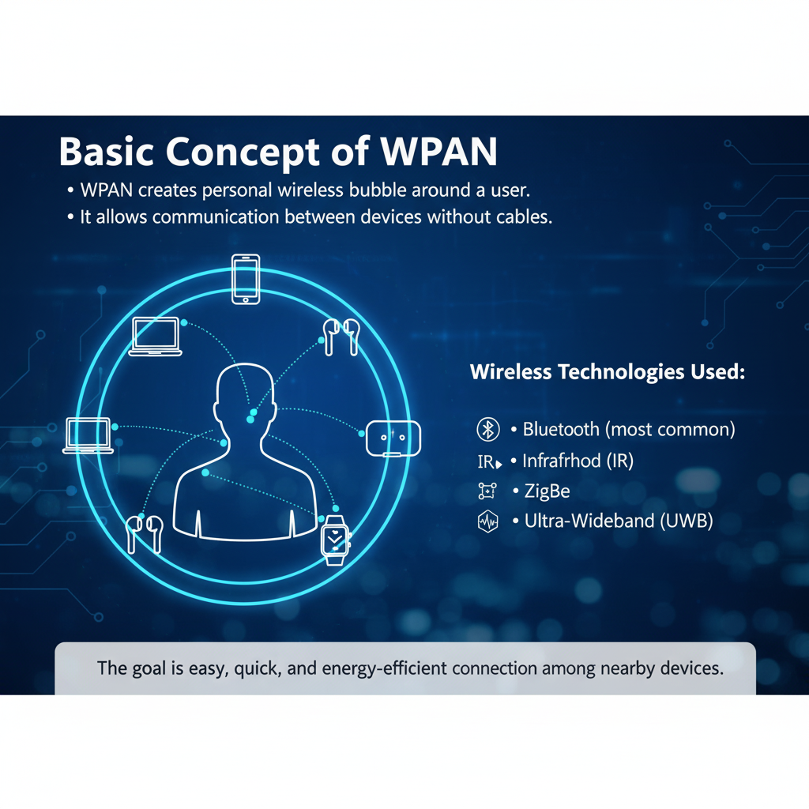

Slide 4
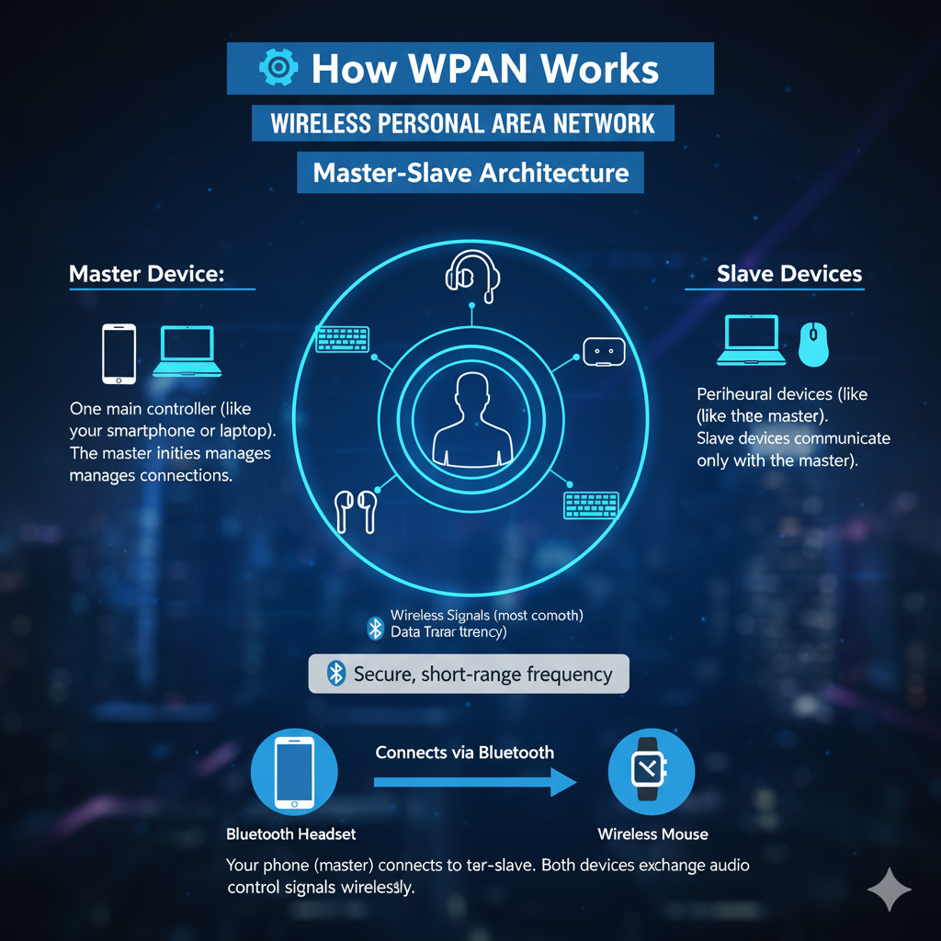

Slide 5
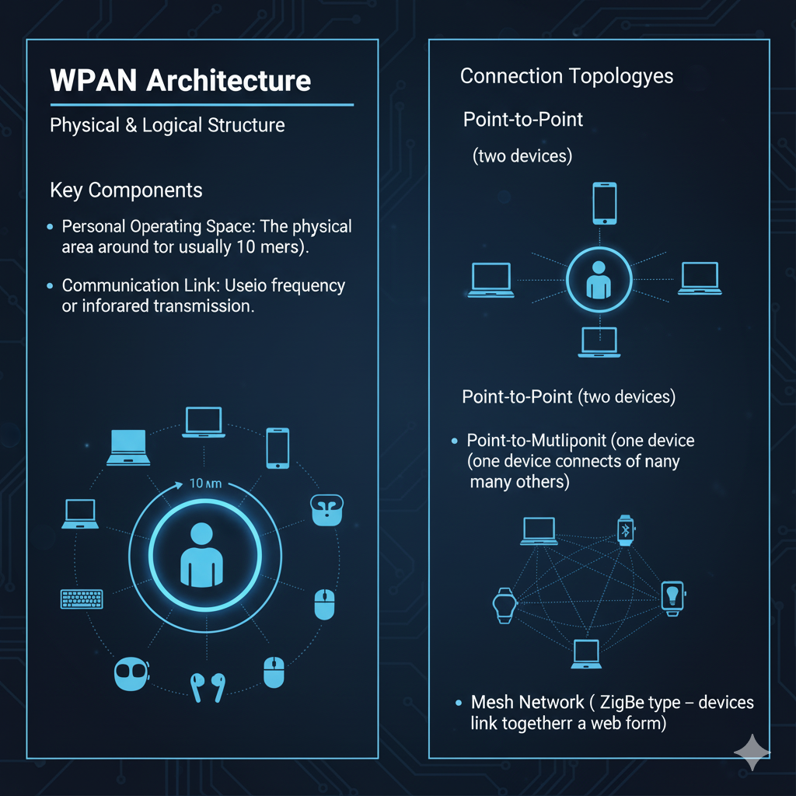

Slide 6
Types of WPAN Technologies
1.Bluetooth
Most popular WPAN technology.
Range: 1–100 meters (depending on class).
Used in headphones, smartwatches, and car systems.
Frequency: 2.4 GHz ISM band.
Versions: Bluetooth 1.0 → 5.3 (improving speed & range).
2.Infrared (IR)
Used in TV remote controls and older mobile devices.
Requires line-of-sight (devices must face each other).
Range: ~1–5 meters.
3.ZigBee
Designed for low power and low data rate.
Used in smart homes, IoT devices, and sensors.
Range: up to 100 meters (in mesh networks).
4.Ultra-Wideband (UWB)
High-speed, short-range technology.
Used in modern smartphones for accurate location tracking.
Example: Apple’s AirTag and smart home positioning.

Slide 7
Features of WPAN
Short range: Typically 10 meters.
Low power consumption: Ideal for battery-powered devices.
Low cost: No expensive setup or infrastructure needed.
Ease of use: Simple pairing and automatic connection.
Supports mobility: User can move freely within range.
Inter-device communication: Connects multiple devices simultaneously.

Slide 8
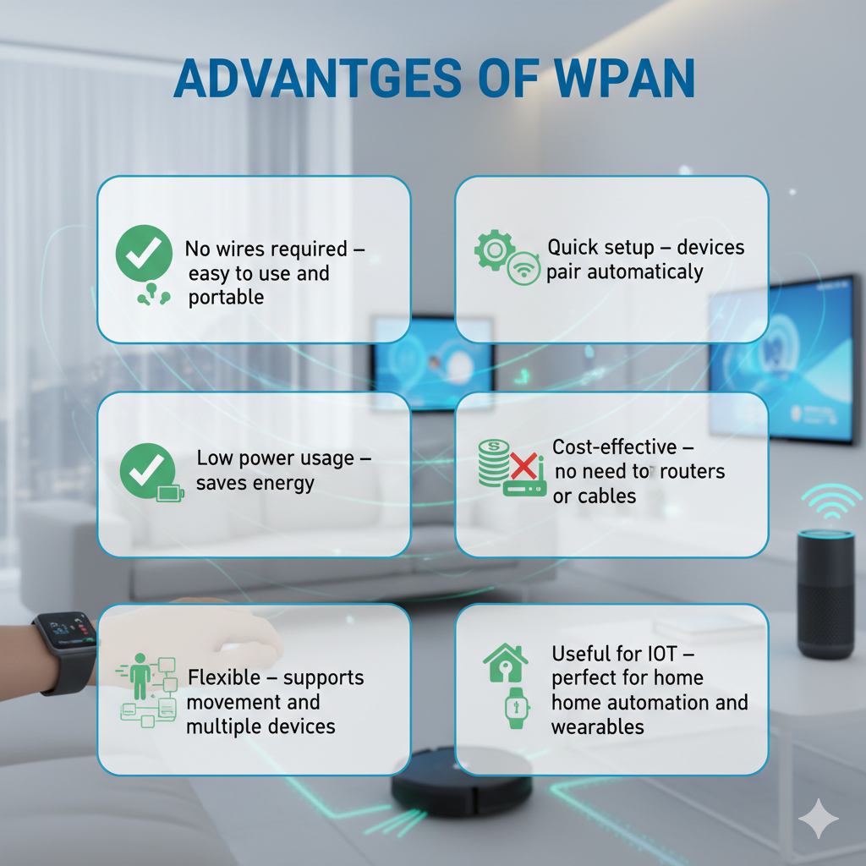

Slide 9
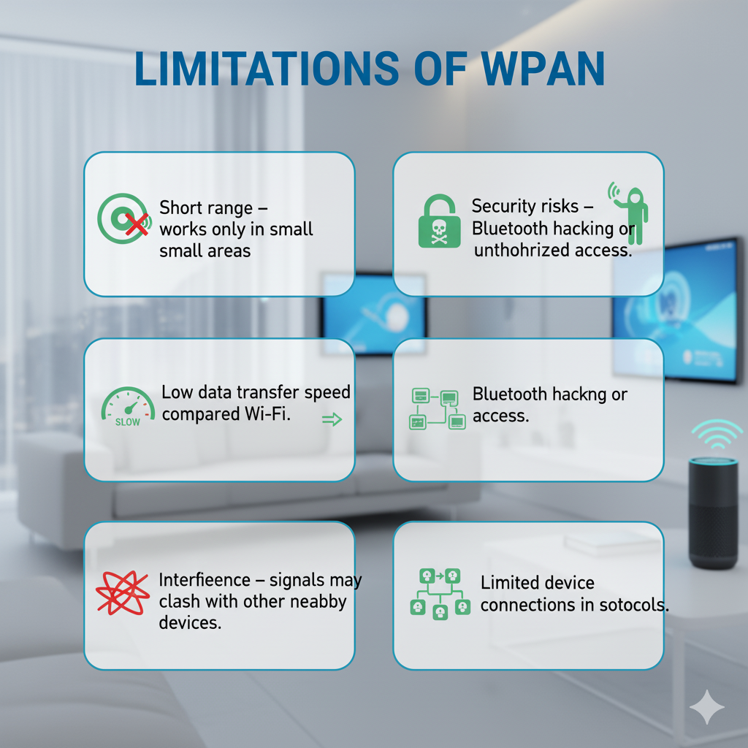

Slide 10
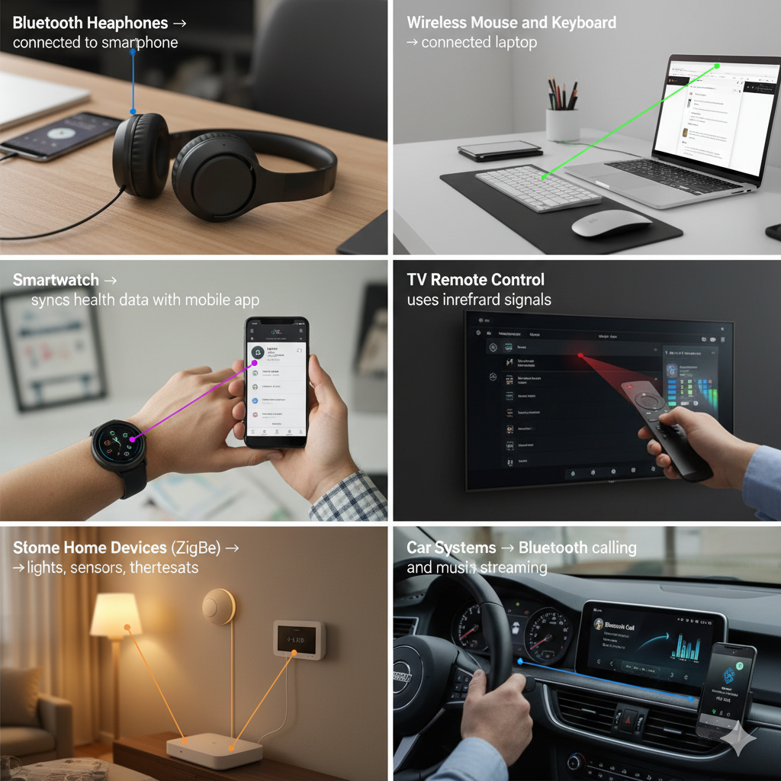
Real-Life Examples

Slide 11
Applications of WPAN
Personal Devices: Phones, tablets, laptops, wearables.
Healthcare: Wireless body sensors and medical monitoring.
Smart Homes: Control of lights, fans, and doors.
Automotive: Hands-free communication systems.
Industrial Uses: Machine-to-machine communication and sensors.

Slide 12
Future of WPAN
Integration with Internet of Things (IoT).
Development of Bluetooth Low Energy (BLE) for better efficiency.
Use in healthcare wearables and smart cities.
Faster and more secure versions of wireless protocols.
WPAN will continue to grow as devices become smaller and smarter.

Slide 13
Summary
WPAN connects personal devices wirelessly in short range.
Common types: Bluetooth, IR, ZigBee, and UWB.
Offers convenience, mobility, and low cost.
Plays a key role in IoT, smart homes, and wearable technology.

